Slide 1
Microsoft Cognitive Services and Custom Vision
Víctor Escudero Rusillo
vescuderorusillo@gmail.com
victor.escudero@bestsecret.com

Slide 2
AI: Building is hard, using is easy
Building AI Models:
ML expertise
Large datasets for training
Compute power
Using AI Models:
Training, tuning and using

Slide 3
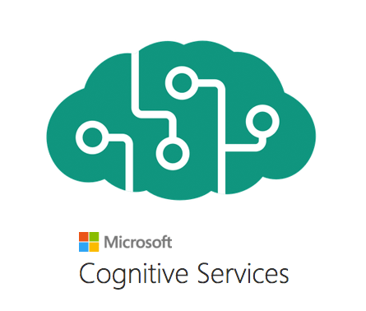
What Are Microsoft Cognitive Services?
Set of APIs that perform specific AI features
Hosted on Microsoft Azure
Enable AI application development

Slide 4
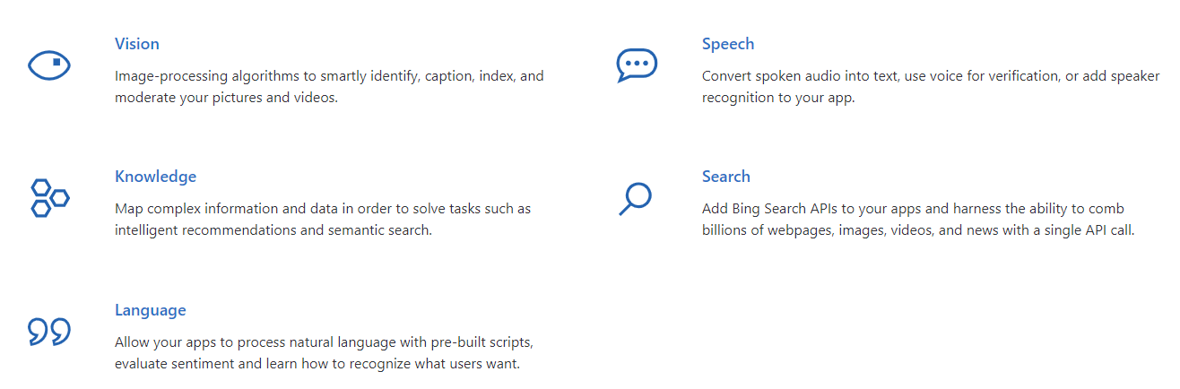
Microsoft Cognitive Services
Infuse your apps, websites and bots with intelligent algorithms to see, hear, speak, understand and interpret your user needs through natural methods of communication.

Slide 5
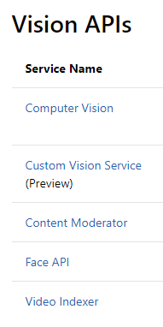
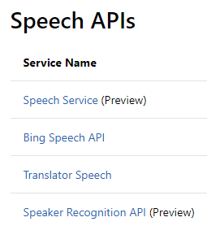
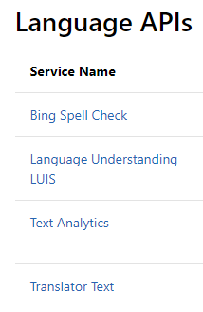
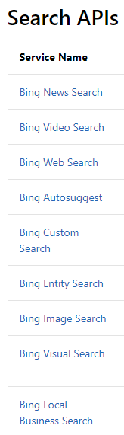
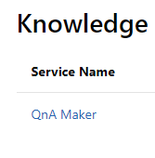

Core AI Features of Cognitive Services

Slide 6
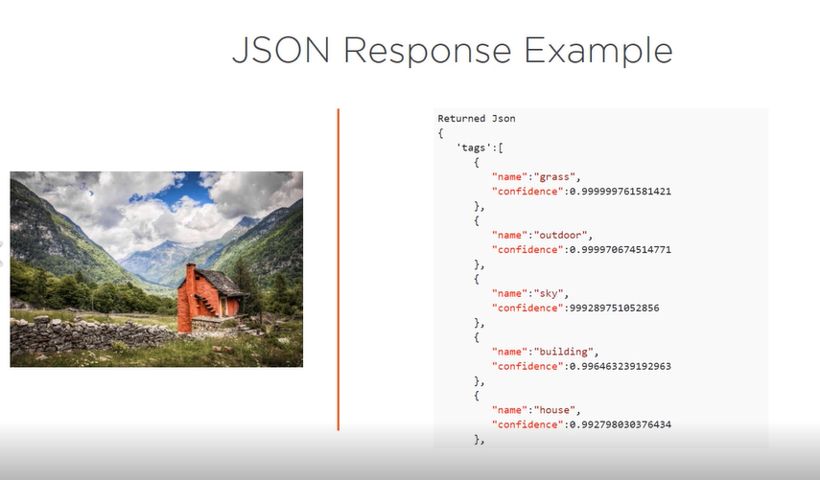
JSON Response Example

Slide 7

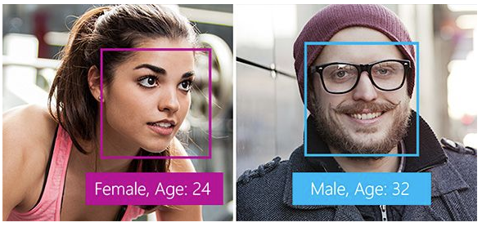
Azure Face API
Face Detection
Detect human face and coordinates
head pose, gender, age, emotion, facial hair, and glasses
Face Verification
Security scenarios
Find similar faces
Face grouping
Person identification

Slide 8

Custom Vision
Azure Custom Vision is a cognitive service that lets you build, deploy and improve your own image classifiers. An image classifier is an AI service that applies labels (which represent classes) to images, according to their visual characteristics. Unlike the Computer Vision service, Custom Vision allows you to determine the labels to apply.

Slide 9
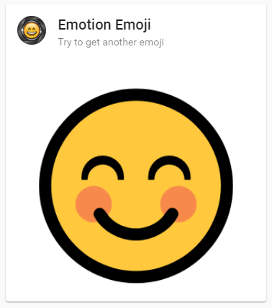
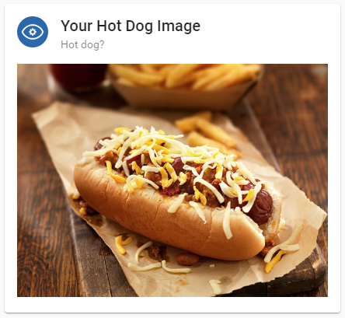
Cognitive Services & Custom Vision Workshop
https://ml-competition.azurewebsites.net/
https://github.com/vescuderorusillo/ml-workshop
Exercise 1: Face Detection
Exercise 2: Hot dog recognition

